Slide 1
Homework 02
Yun-Zhen, Cai: P76084172@gs.ncku.edu.tw
Sheng-Yi, Yao: ND8081018@gs.ncku.edu.tw

Slide 2
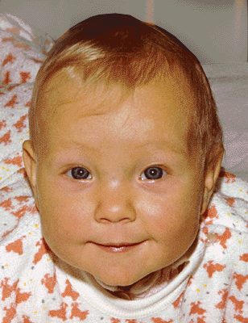
Goal
Write an executable program with the following feature.
  Feature-Based Image Metamorphosis
    Beier et al.
    https://dl.acm.org/doi/10.1145/133994.134003
Animated-morphing.gif – Koperczak – public domain
https://en.wikipedia.org/wiki/File:Animated-morphing.gif

Slide 3
Goal
Input
  2-3 color images as morphing input.
    Make sure all the image size and channel are the same.
  Feature line segment
    You can put them in code, separated text file or let user draw on GUI window.
  Alpha value
    From 0 to 1.

Slide 4
Goal
Output
  Single warped image result from all image(Before color blending).
  Final warping result (After color blending).

Slide 5
Additional
You will receive additional score if you successfully implement the following feature.
  Drawable user control feature line in GUI interface. (+1)
    User can control the feature line by himself.
  Warping animation. (+1)
    Continuously show the morphing result with alpha value from 0 to 1.

Slide 6
Additional
You will receive additional score if you successfully implement the following feature.
  Multiple image sequentially morphing animation. (+2)
    Image A -> Image B -> Image C -> Image A
  Multiple image blending. (+3)
    Polymorph: Morphing Among Multiple Images
      Lee et al.
      https://ieeexplore.ieee.org/document/637304

Slide 7
Requirement
Use moodle
  http://moodle.ncku.edu.tw/
  We will update the homework news there.

Slide 8
Requirement
Any operating system is welcome.
Any compiler and language is welcome.
Any external library is welcome.
  You can use the basic data structure and basic algorithm from the library.
Any platform / language / compiler / library will not receive an impact factor of the score.
  Only the program, code, and user manual affect.

Slide 9
Requirement
You MUST implement the warping algorithm by yourself.
  Any ready-made warping algorithm is prohibited and will receive score penalty.
You MUST implement the feature line warping algorithm based on the paper we given.
  Any other algorithm is prohibited and will receive score penalty.

Slide 10
What we give
Paper
  https://dl.acm.org/doi/10.1145/133994.134003
  You need to implement this feature from this paper.
Class lecture
  It tells you the overall feature of the paper.

Slide 11
What you do
Write your own code.
  TA will check your code.
  Plagiarism is not allowed.
    Include copy code from existing project.

Slide 12
What we expect
Executable program
  Load the picture in your own ways.
  Can see the feature line vector.
  Expect to see the warping result.

Slide 13
What we expect
FULL source code
  Prevent from failed program.
Readme file
  Hardware and software requirement.
  Program overview.
  Operations manual.
  Any thing you wish to tell us.

Slide 14
Score
You will get 83 when you submit in time.
Dead program will receive 73.
  Please hand in homework even if you cannot finish in time.
No submission take 0 score.
You will receive score penalty (1 - 10) if you violate the homework requirement.
  Check the requirement carefully.
TA has the right to adjust your score.

Slide 15
Deadline
Hand in before 2020-10-19 23:55 (YYYY-MM-DD hh:mm)
Late submit will receive score penalty.
  Unless you have a good reason.
Teaching assistant have the right to add, modify, cancel the homework.
Please do not fool us. d(`･∀･)b

